Slide 1
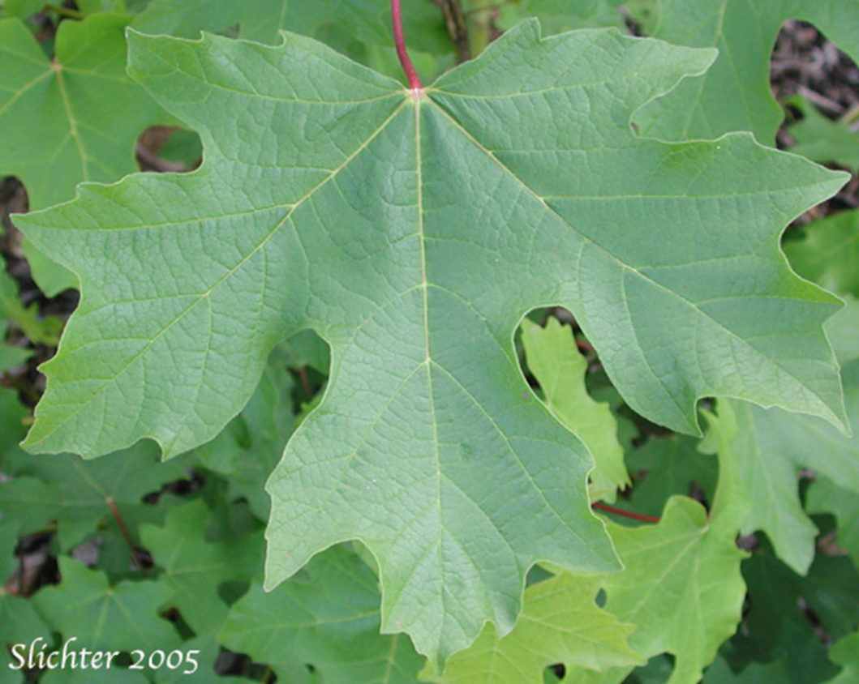
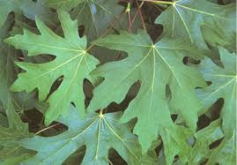
Bigleaf Maple

Slide 2
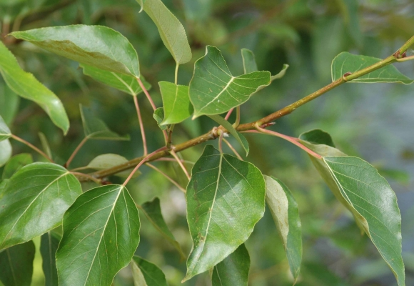
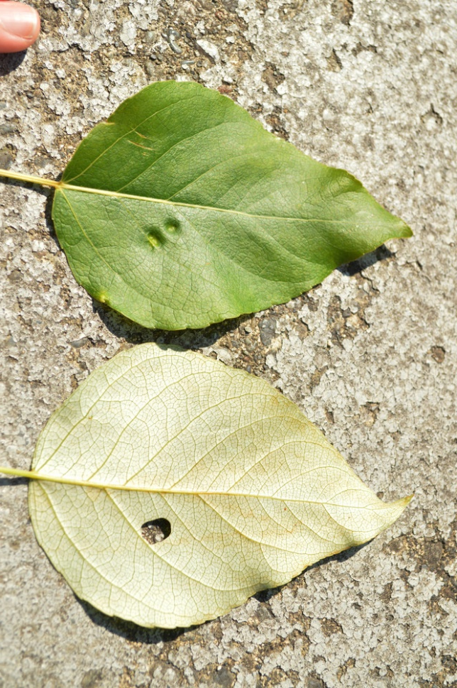
Black Cottonwood

Slide 3
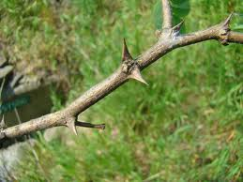
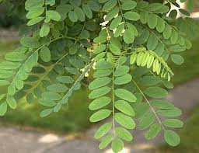
Black Locust

Slide 4
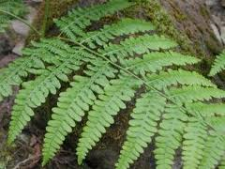
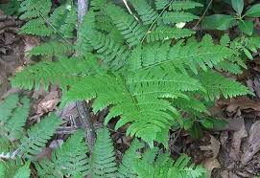
Bracken Fern

Slide 5
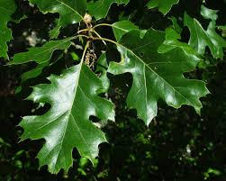
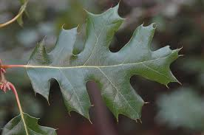
California Black Oak

Slide 6
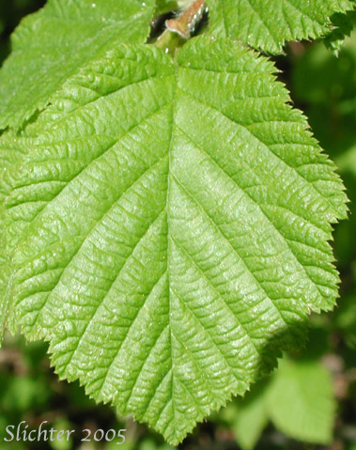
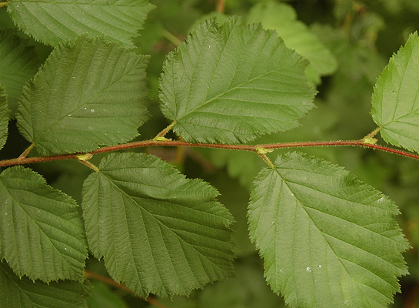
California Hazel

Slide 7
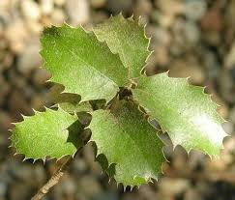
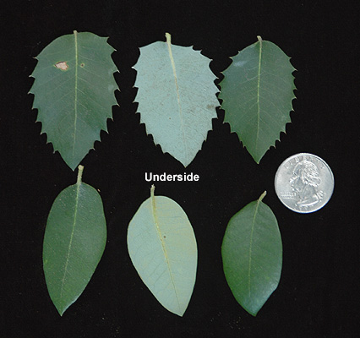
Canyon Live Oak

Slide 8
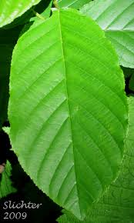
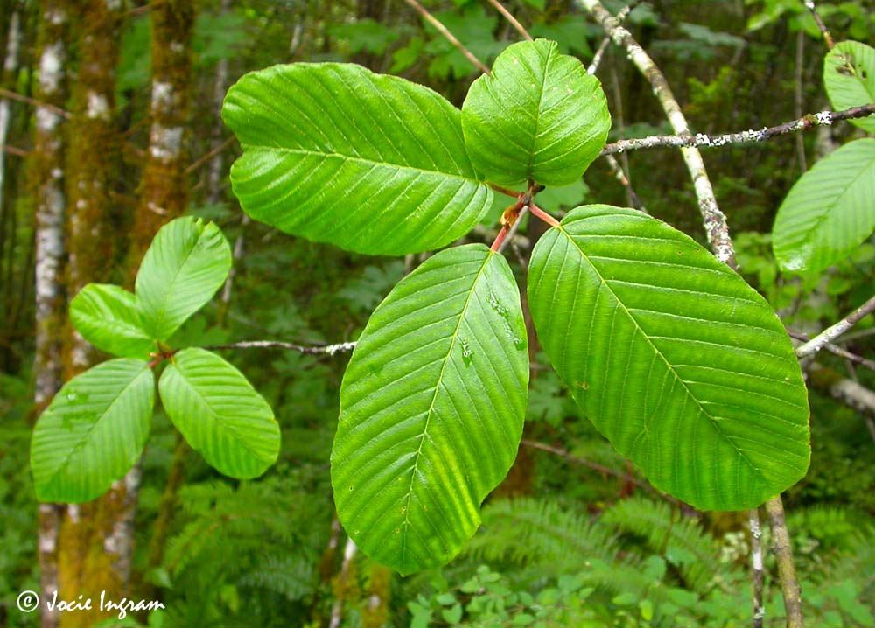
Cascara Buckthorn

Slide 9
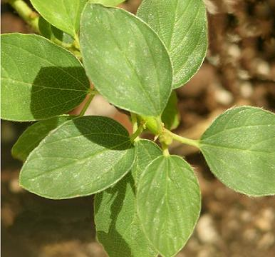
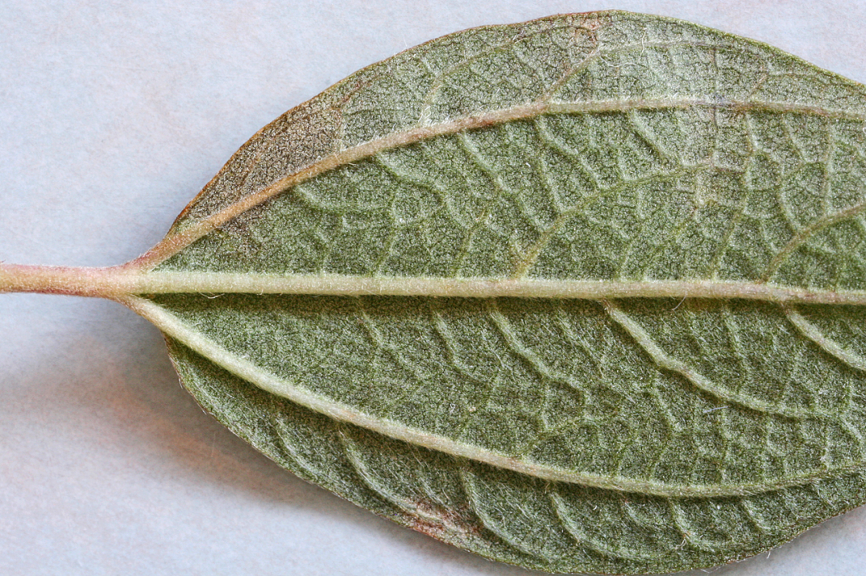
Ceanothis

Slide 10
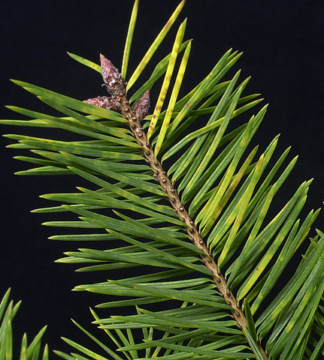
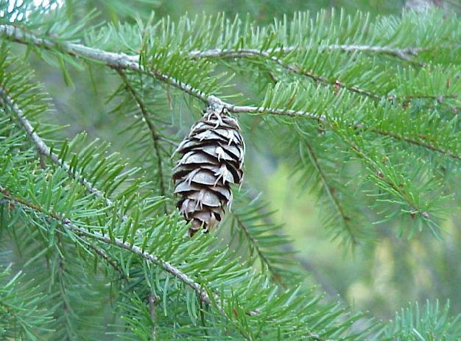
Douglas Fir

Slide 11
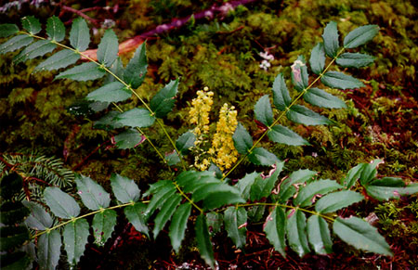
Dwarf Oregon Grape

Slide 12
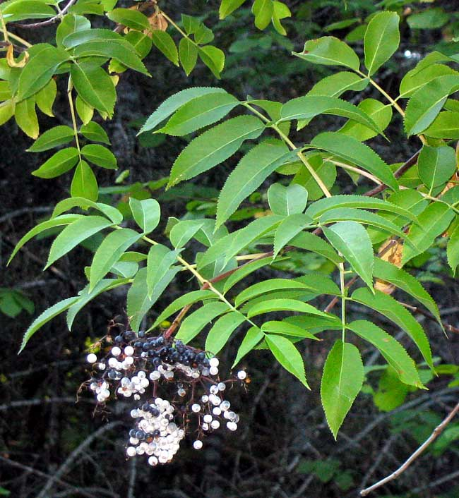
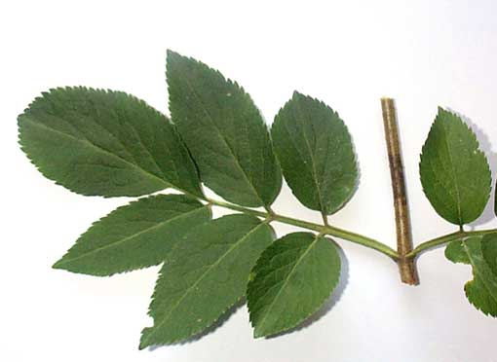
Elder

Slide 13
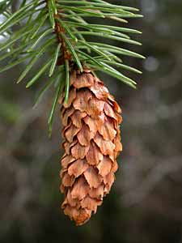
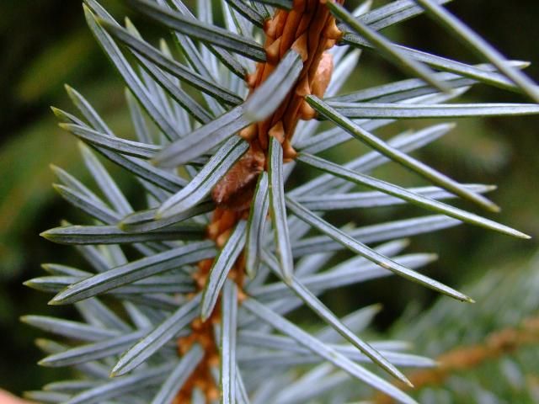
Sitka Spruce

Slide 14
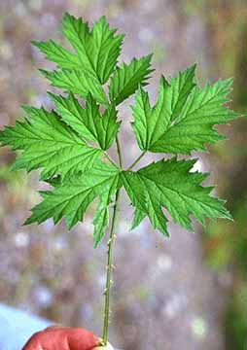
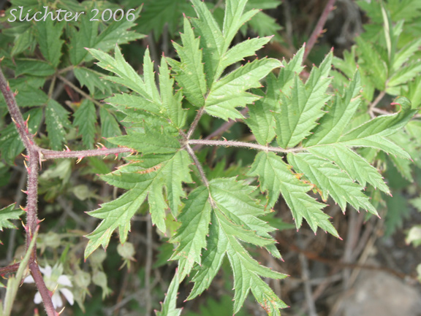
Evergreen Blackberry

Slide 15
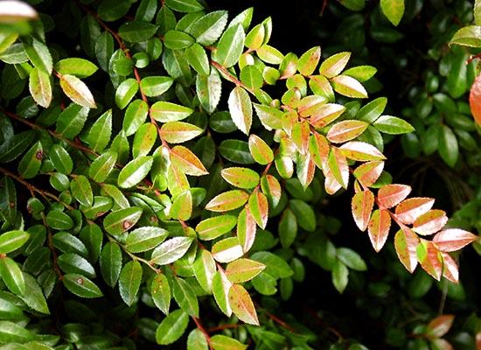
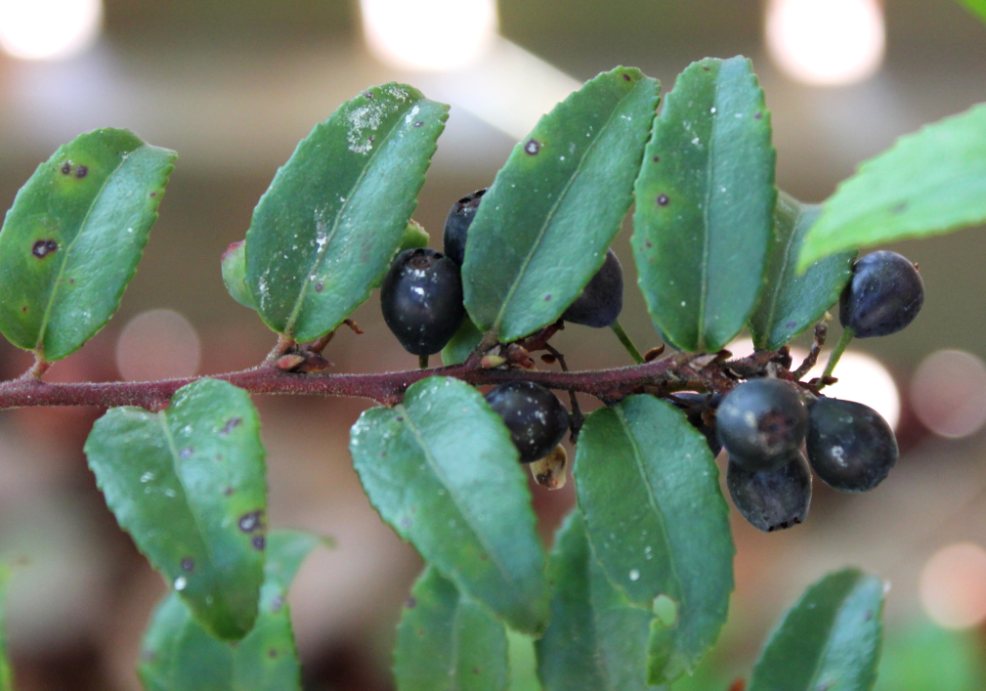
Evergreen Huckleberry

Slide 16
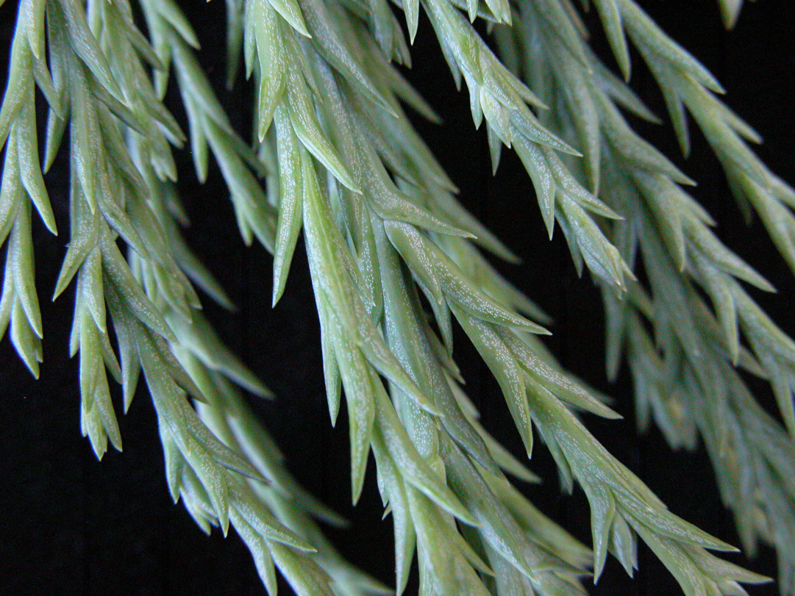
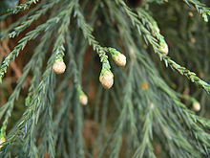
Giant Sequoia

Slide 17
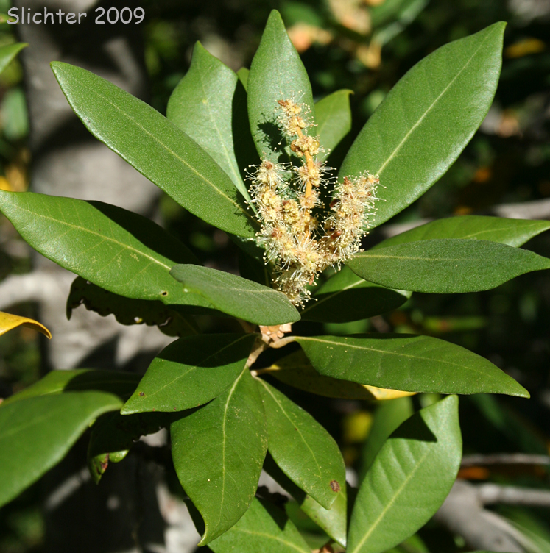
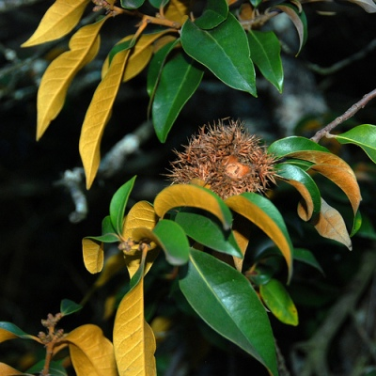
Golden Chinkapin

Slide 18
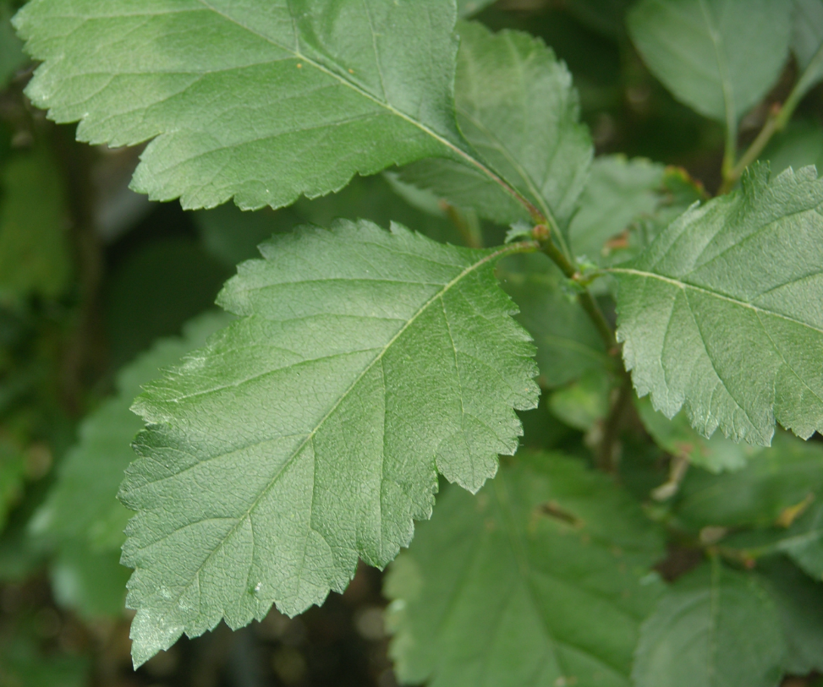
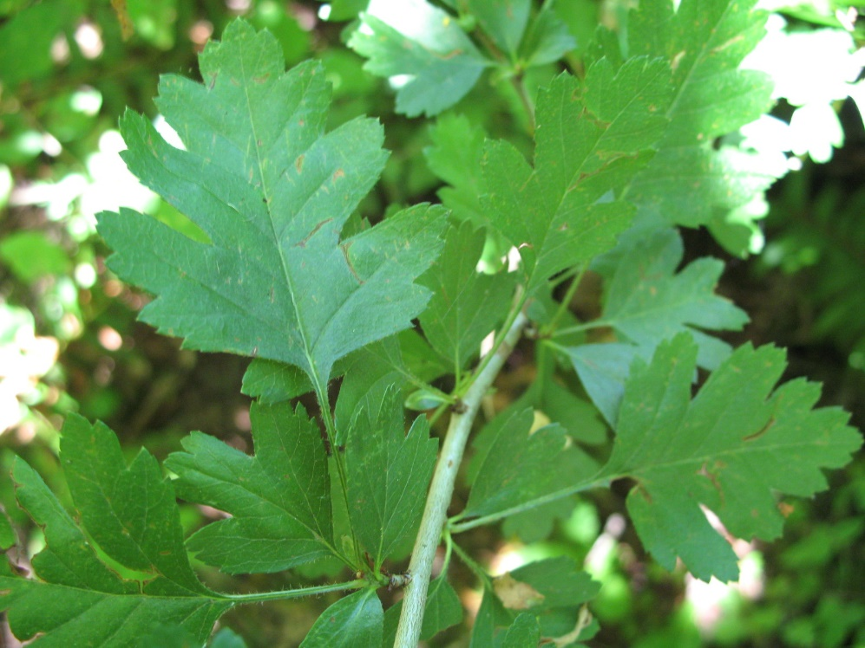
Hawthorn

Slide 19
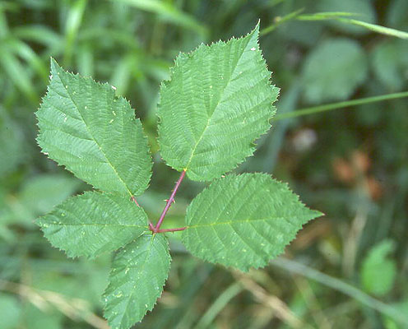
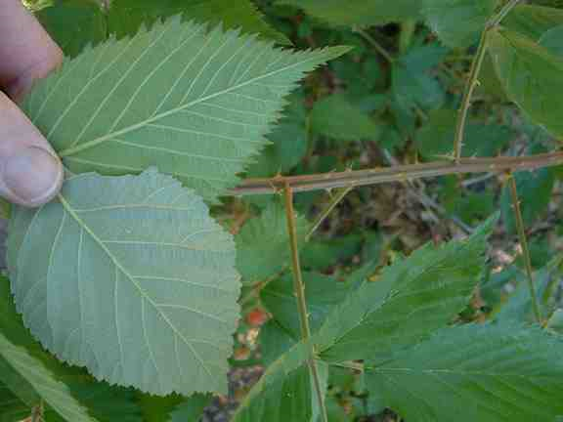
Himalaya Blackberry

Slide 20
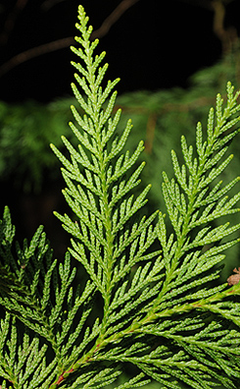
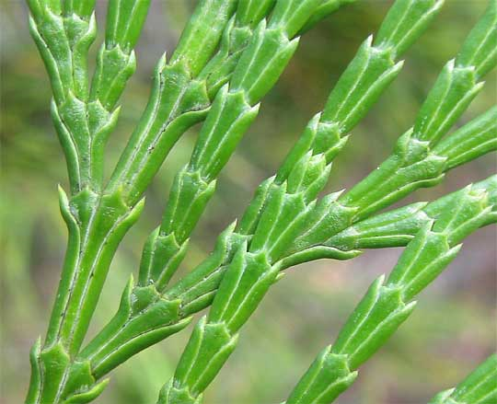
Incense Cedar

Slide 21
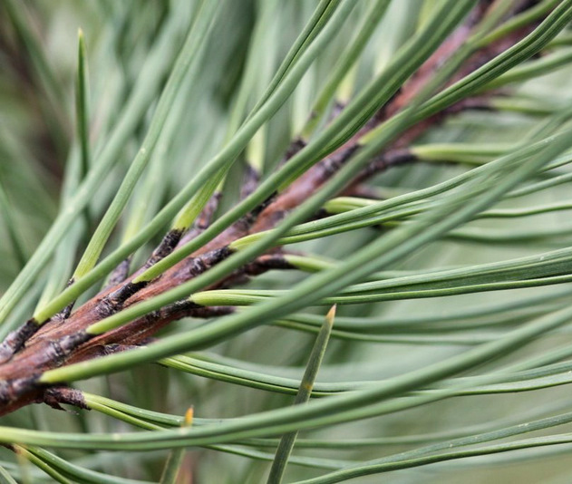
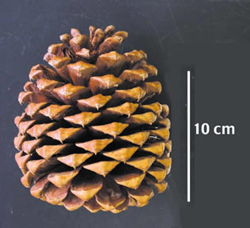
Jeffery Pine

Slide 22
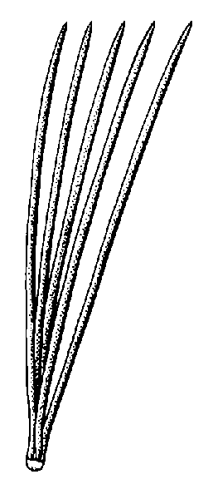
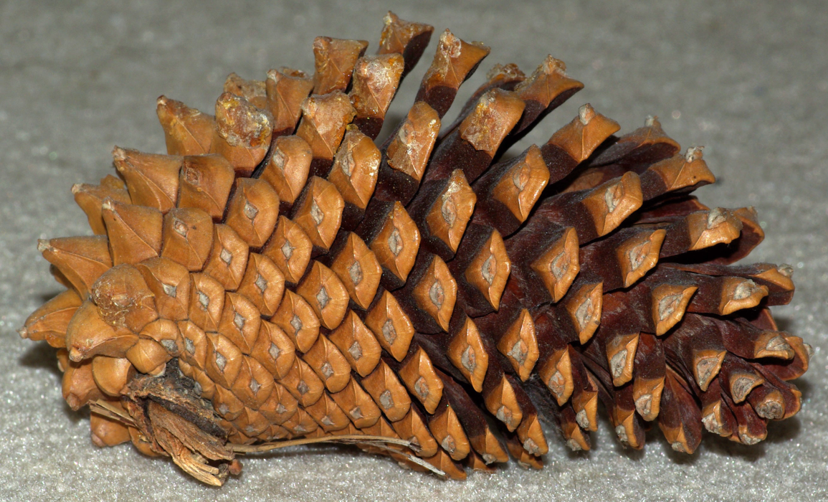
Knobcone Pine

Slide 23
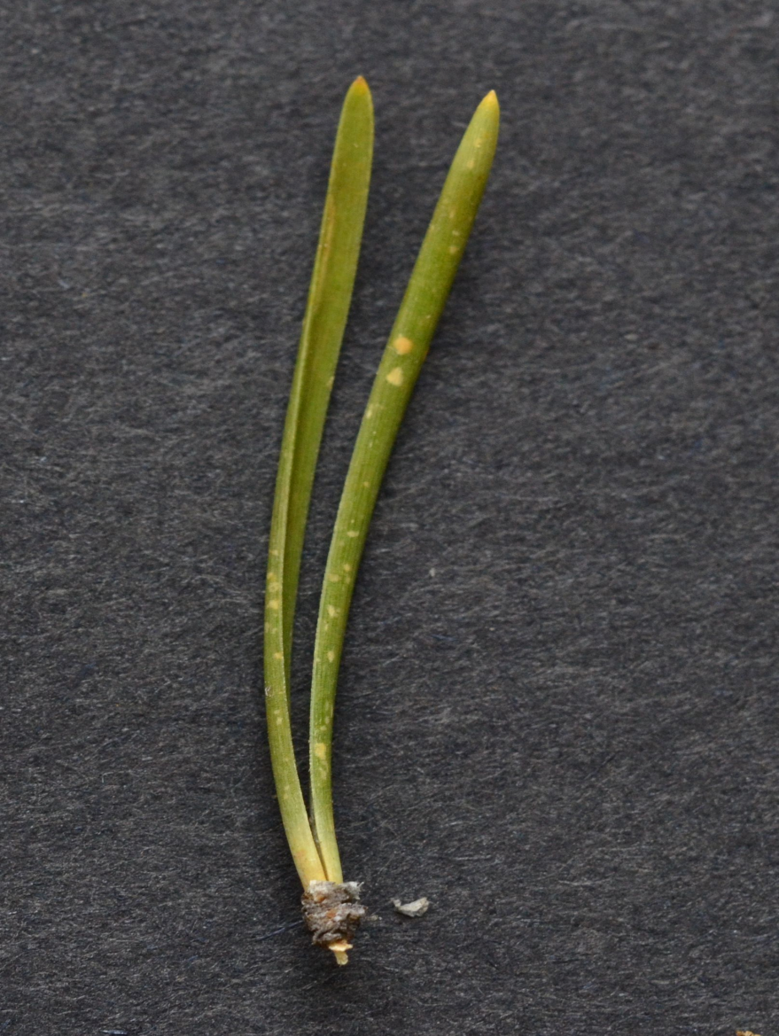
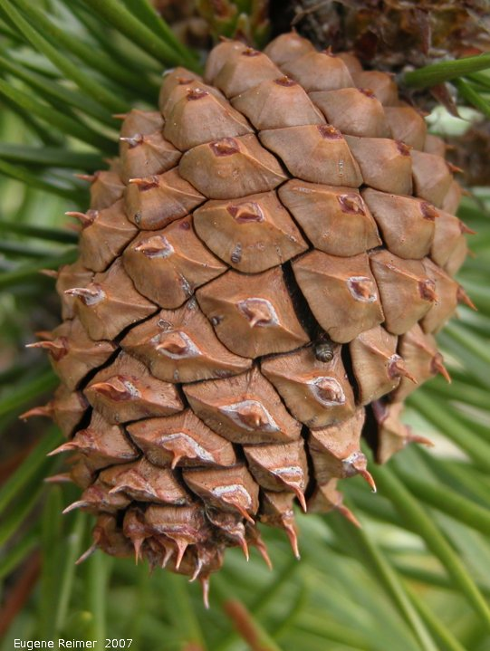
Lodgepole Pine

Slide 24
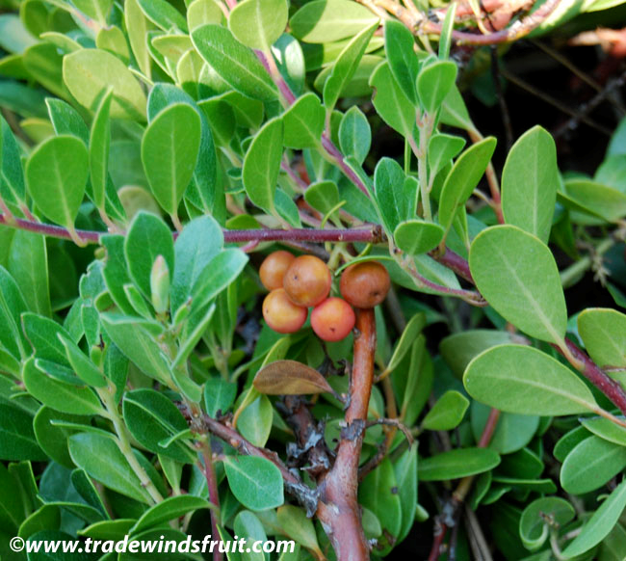
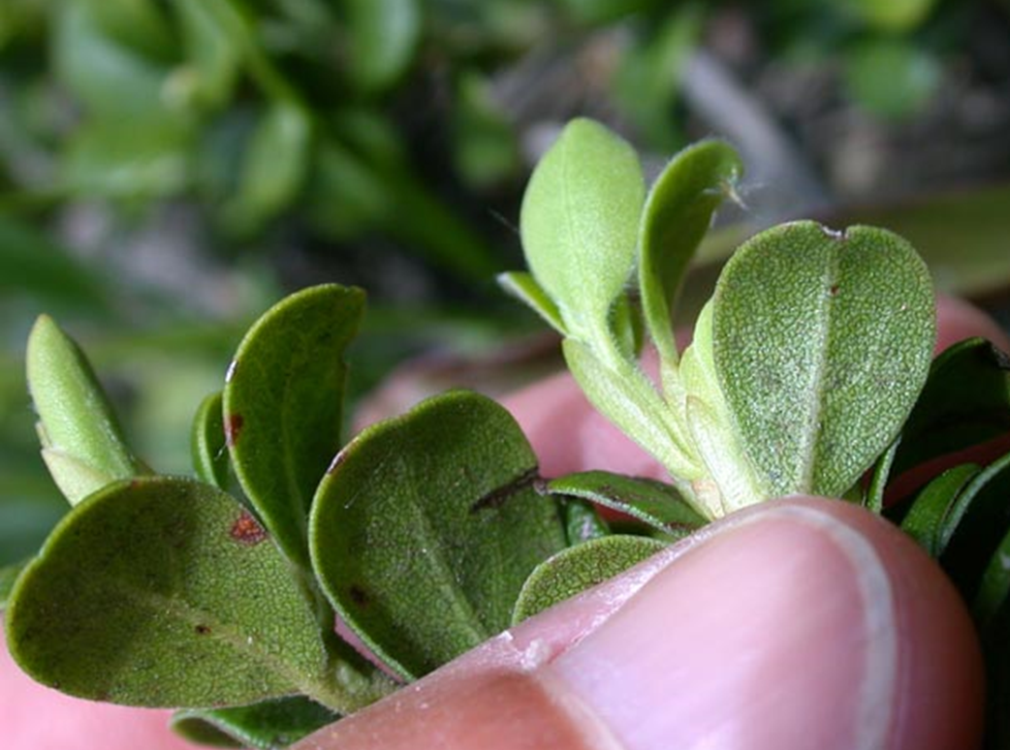
Manzanita

Slide 25
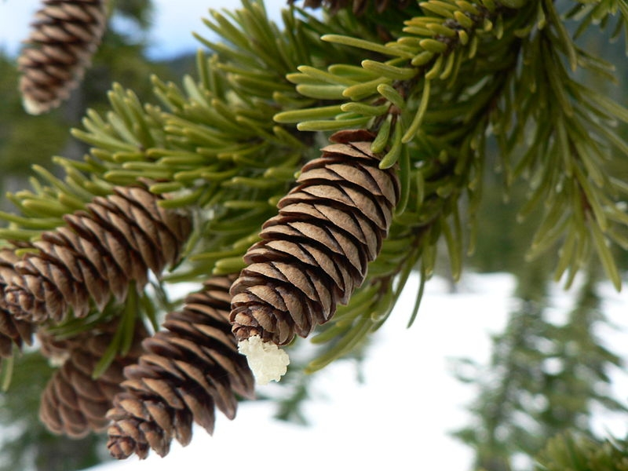
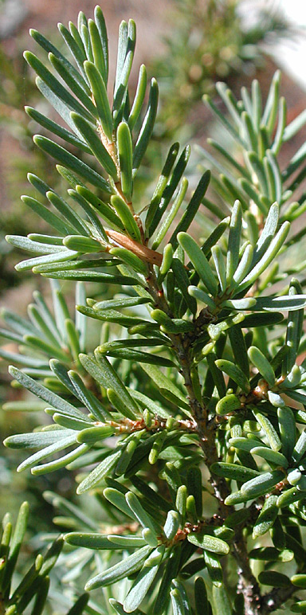
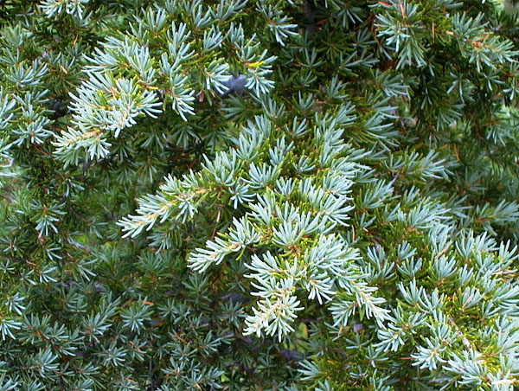
Mountain Hemlock

Slide 26
Mountain Mahogany

Slide 27
Ninebark

Slide 28
Noble Fir

Slide 29
Ocean Spray

Slide 30
Oregon Crab Apple

Slide 31
Oregon Ash

Slide 32
Oregon Myrtle

Slide 33
Oregon White Oak

Slide 34
Pacific Dogwood

Slide 35
Pacific Silver Fir

Slide 36
Pacific Madrone

Slide 37
Pacific Yew

Slide 38
Ponderosa Pine

Slide 39
Port Orford Cedar

Slide 40
Quaking Aspen

Slide 41
Red Alder

Slide 42
Red Huckleberry

Slide 43
Redwood

Slide 44
Rhododendron

Slide 45
Salal

Slide 46
Salmonberry

Slide 47
Scotch Broom

Slide 48
Sugar Pine

Slide 49
Sword Fern

Slide 50
Tall Oregon Grape

Slide 51
Tan Oak

Slide 52
Thimble Berry

Slide 53
Vine Maple

Slide 54
Western Hemlock

Slide 55
Western Larch

Slide 56
Western Juniper

Slide 57
Western Redcedar

Slide 58
Western White Pine

Slide 59
Wild Cherry

Slide 60
White Fir/Grand Fir

Slide 61
Willow

